Slide 1
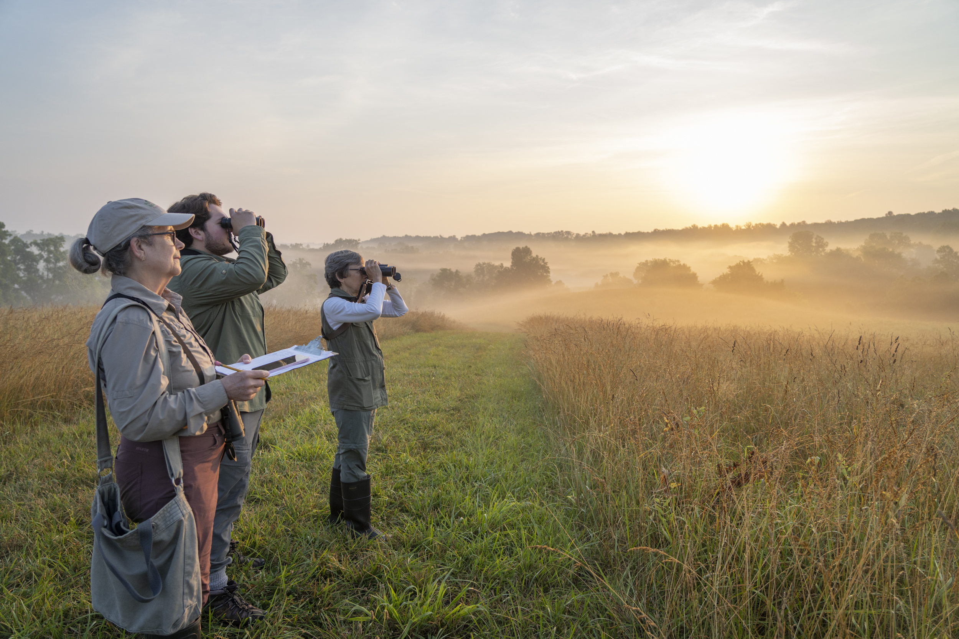
VWL Grassland Biodiversity Bird Surveys
Notes:
Now for the fun stuff! Let's talk about what we're all here for- to learn more about the VWL grassland biodiversity surveys!
The goals of these surveys are to...

Slide 2
Goals of VWL Bird Surveys
To advance our understanding of the relationship between grassland bird populations, habitat structure, and land management practices.
Identify landscape features that correlate with the occurrence of target grassland species.
Provide landowners and land managers with species lists specific to their properties and land management practices.
Engage the community through use of volunteer naturalists on the importance of grassland bird conservation.
Without support from our incredible community scientist team, we would not be able to make as significant of an impact as we are. Thank you for all you do!
Notes:
Now for the fun stuff! Let's talk about what we're all here for- to learn more about the VWL bird surveys!
The goals of these surveys are to...
To advance our understanding of the relationship between grassland bird populations, habitat structure, and land management practices.
Identify landscape features that correlate with the occurrence of target grassland species.
Provide landowners and land managers with species lists specific to their properties and land management practices.
Engage the community through use of volunteer naturalists on the importance of grassland bird conservation.
Without support from our incredible community scientist team, we would not be able to make as significant of an impact as we are. Thank you for all you do!

Slide 3
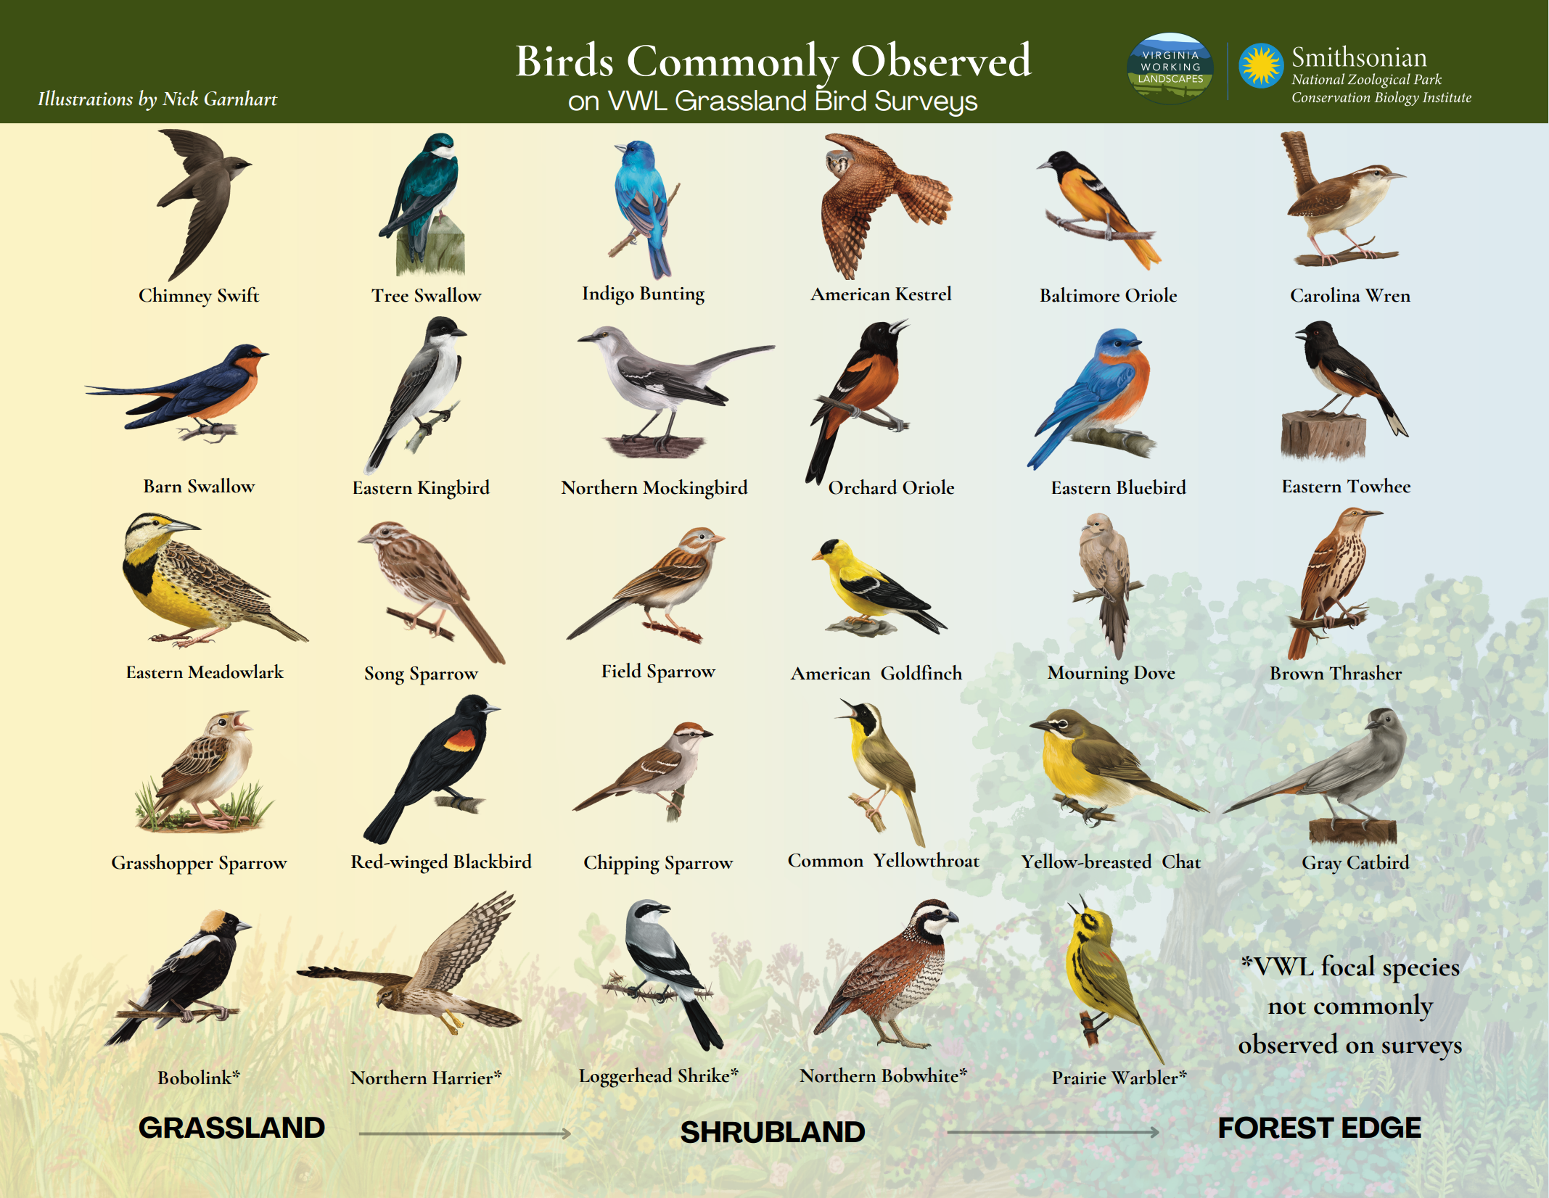
Goals of VWL Bird Surveys
Notes:
Here are some examples of the species commonly observed during our grassland bird surveys. You may be familiar with some of these species by sight and sound.
We observe grassland birds through a method called a "point count" survey. You may not all be familiar with this term, so I'd like to explain this survey method in more detail.

Slide 4
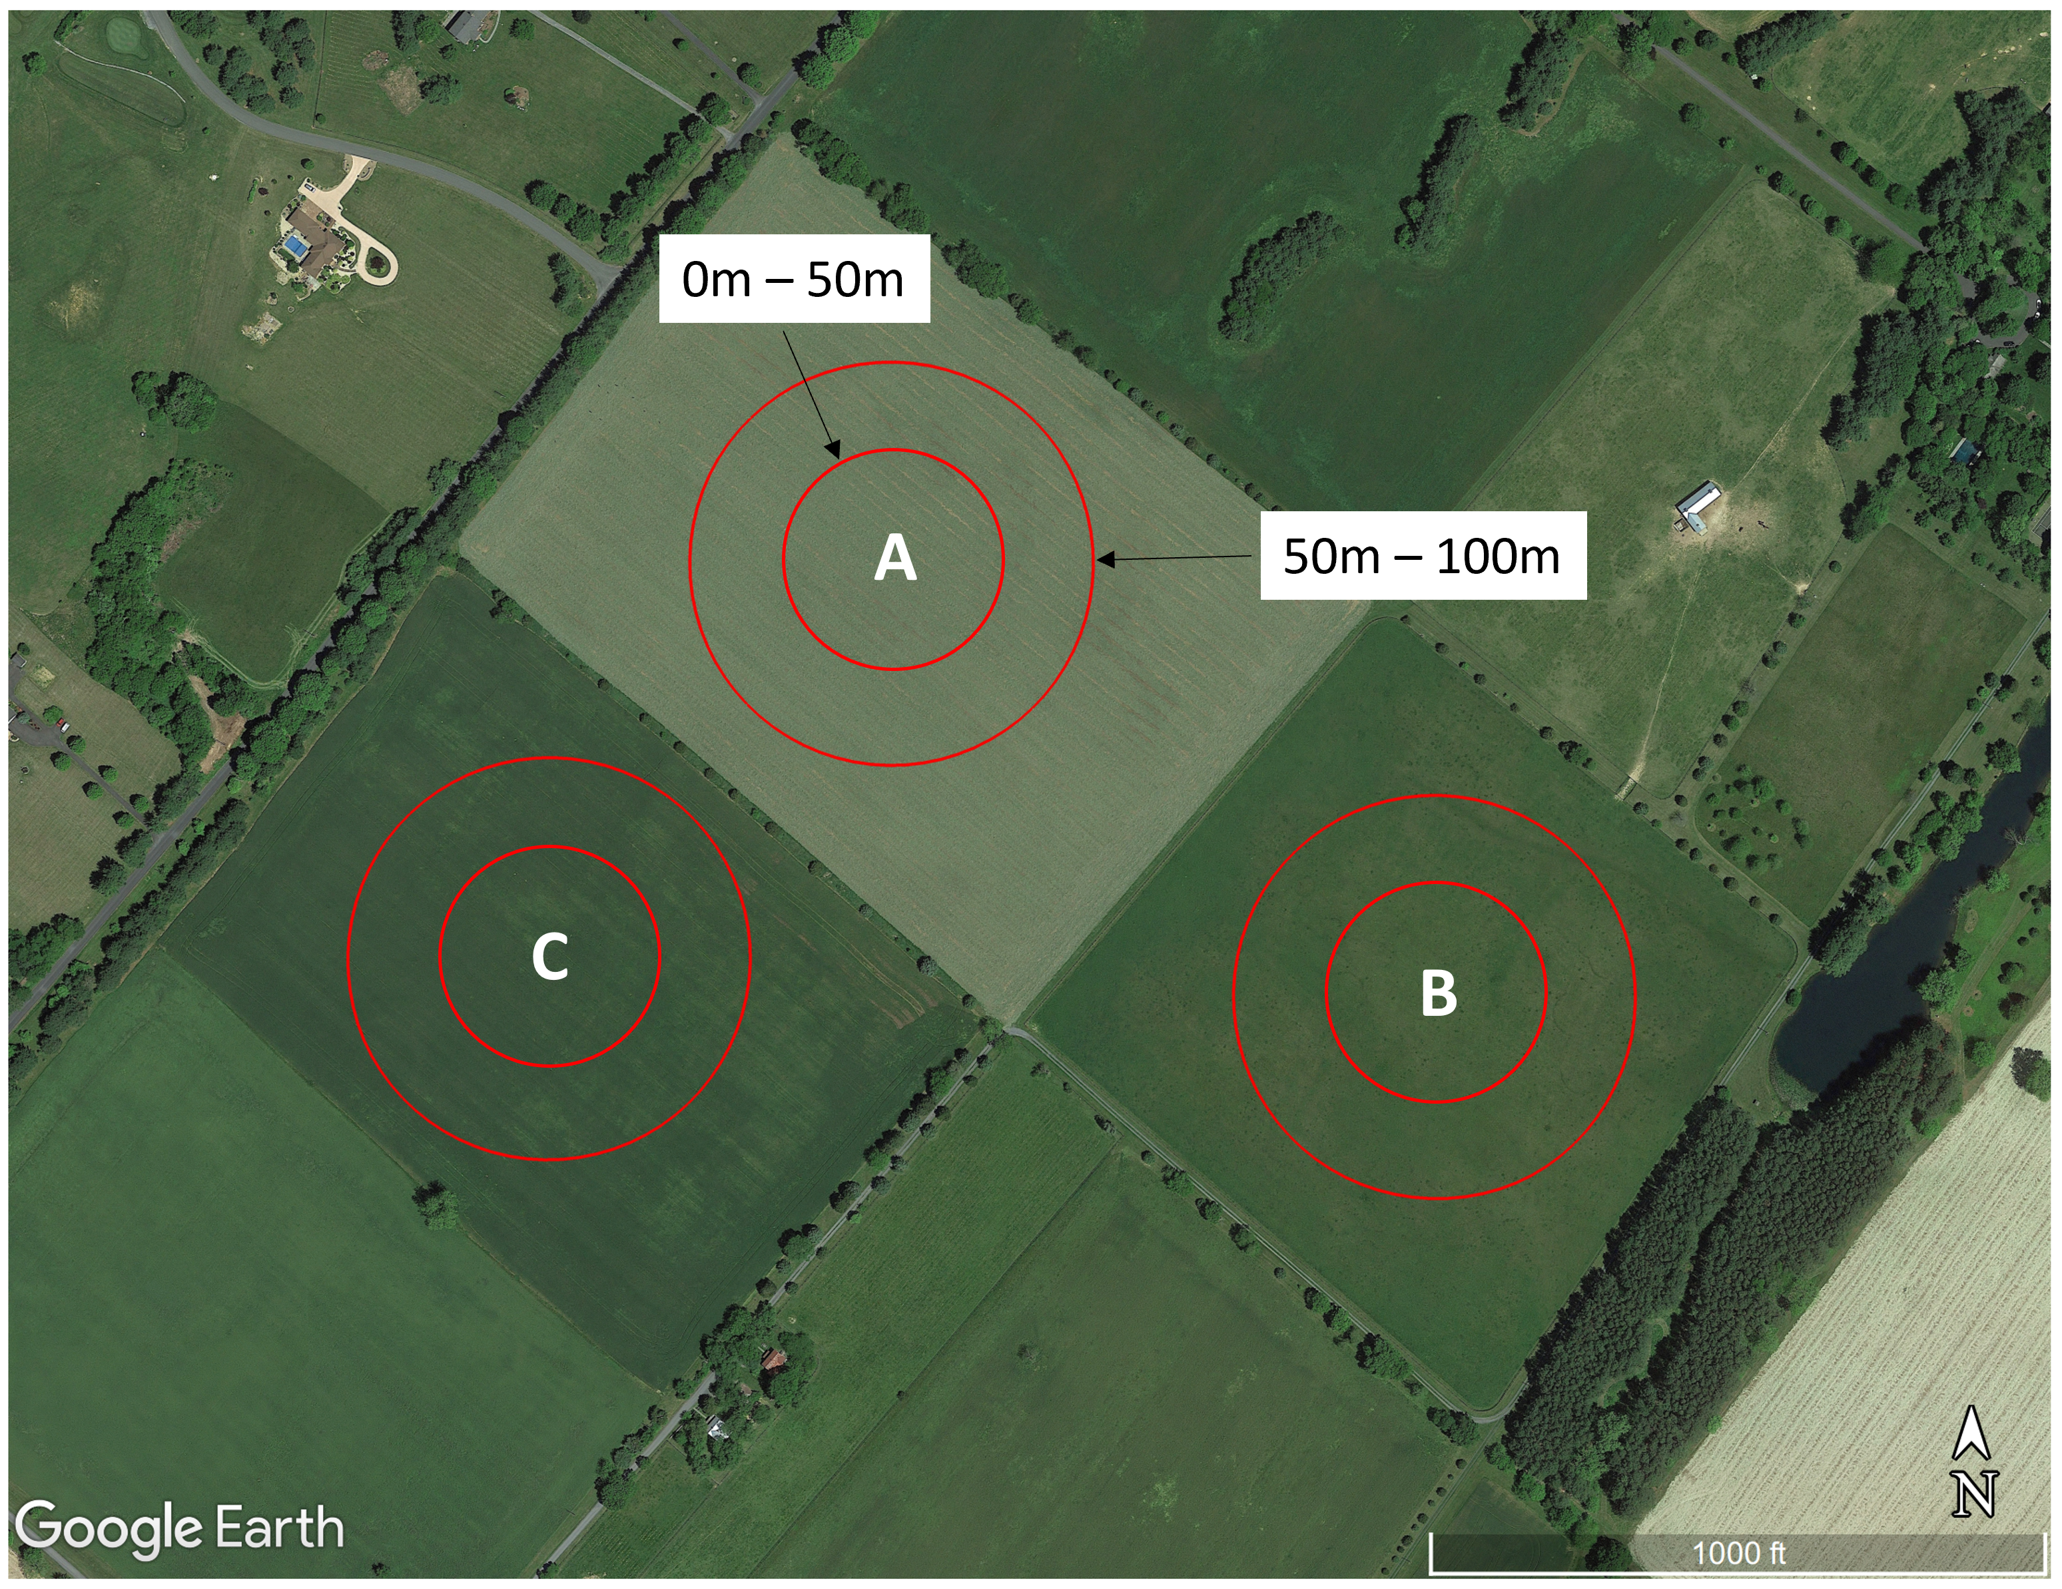
Goals of VWL Bird Surveys
Bird surveys are carried out using a point count method. Community scientists stand at predetermined points (labeled A, B, & C) within survey fields and note every bird they see and hear within two distance bands (0 – 50m and between 50 – 100m) for a total of 10 minutes
Notes:
“Point counts are one of several methods used to inventory and monitor bird populations. A point count is a tally of all birds detected by sight and sound by a single observer located at a fixed position during a specified period of time. Counts are usually conducted in the mornin, typically during the breeding season when birds are most vocal and territorial. Counts must also be conducted under suitable weather conditions.”
For VWL surveys, community scientists stand at predetermined points within survey fields and note every bird they see and hear within two distance bands (< 50 m and between 50 – 100 m) for a total of 10 minutes. I'll explain this process in more detail shortly.

Slide 5
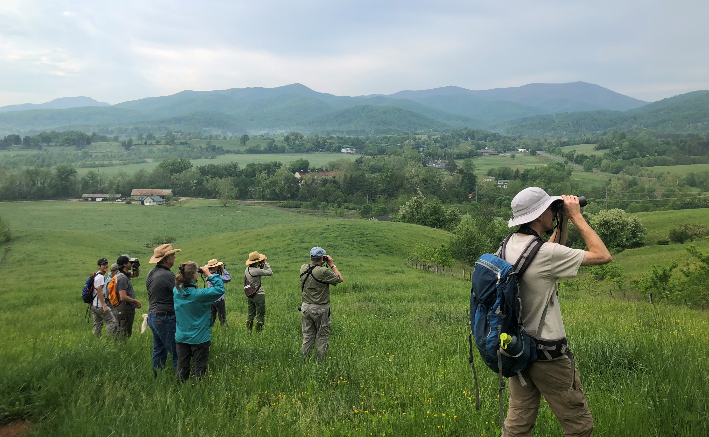
Before Surveying
Notes:
So, before we conduct a point count survey, we need to make sure we’re prepared

Slide 6
Equipment Needed
Required | Recommended
Binoculars | Sun protection (hats, sunscreen)
Clipboard with datasheets, survey manual and site map | Insect repellant
Pencils (>5) and blank note sheets | First Aid kit
Stopwatch | Field Guide
Water | Camera/Recording device (optional)
Long pants & sturdy field boots | Range finder/Measuring tape (optional)
VWL Parking Sign (provided by VWL)
GPS Unit or Navigation App on phone
Notes:
Firstly, it’s important to ensure you have all of the required survey equipment being:
- binoculars
- clipboard with datasheets, survey manual, and site map
- pencils (with extras in case you lose or break them during surveying) *the grass can get pretty tall and swallow things easily!
- stopwatch (most have on phone)
- water
- long pants and sturdy field boots
- VWL Parking sign (we’ll provide this)
- GPS unit or navigation app on phone
We strongly encourage surveyors to wear proper sun and insect protection and to have a first aid kit while in the field. Field guides can be heavy, but useful to have at least in your car

Slide 7
Survey Timing/Schedule
May 15 – May 25
Visit 1
May 29 – June 8
Visit 2
June 12 – June 22
Visit 3
May
June
Each site is surveyed 3 times
Visits should be at least 4 days apart
Survey within 3 hours of sunrise
Coordinate with your partner(s), survey site landowner(s), and the VWL Survey Coordinator
Notes:
Each site is surveyed 3 times by the assigned surveyors, all between May 15th and June 30th. Recommended visit dates are:
Visit 1: May 15 – May 25
Visit 2: May 29 – June 8
Visit 3: June 12 – June 22
- Visits should be at least 4 days apart.
Many of our survey properties are privately-owned, and as such we ask that you coordinate with your partner(s) before early May to schedule 5 visits for each property and to discuss your tentative schedule with the landowner or manager and the VWL Survey Coordinator.
- the 5 visits are 3 official survey visits and 2 extra delays in case of bad weather.
In general, surveys should be carried out within 3 hours of sunrise. However, the end of June tends to bring much warmer temperatures. Carry out your surveys as close to sunrise as possible during this time, and no later than 9am.
If possible, try surveying your points in different orders for each visit as some birds are active at different parts of the morning

Slide 8
Notes:
Survey waypoints will be provided to survey teams as GPS points on site directions and are identified as point A, B or C in the site map (here is an example image).
These waypoints are placed at least 200 meters apart from one another in most fields so that survey plots do not overlap. Where plots do overlap slightly, use your judgment to identify a boundary line in the middle so you do not count the same area twice.
During your first visit, orient yourself with landscape features in the field to help you establish boundaries and distance bands. If available to you, a range finder or measuring tape can be used to measure your distance bands (0 – 50m and between 50 – 100m).

Slide 9
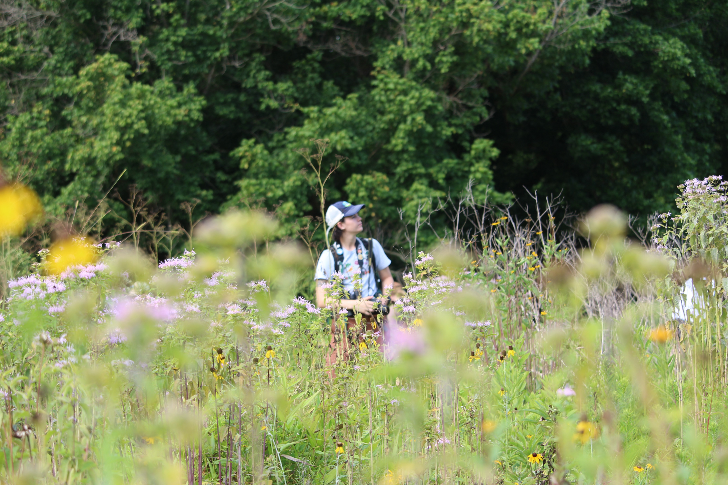
During Survey
Notes:
Now it’s time to conduct a survey! We’ll walk through an example survey datasheet for the next section

Slide 10
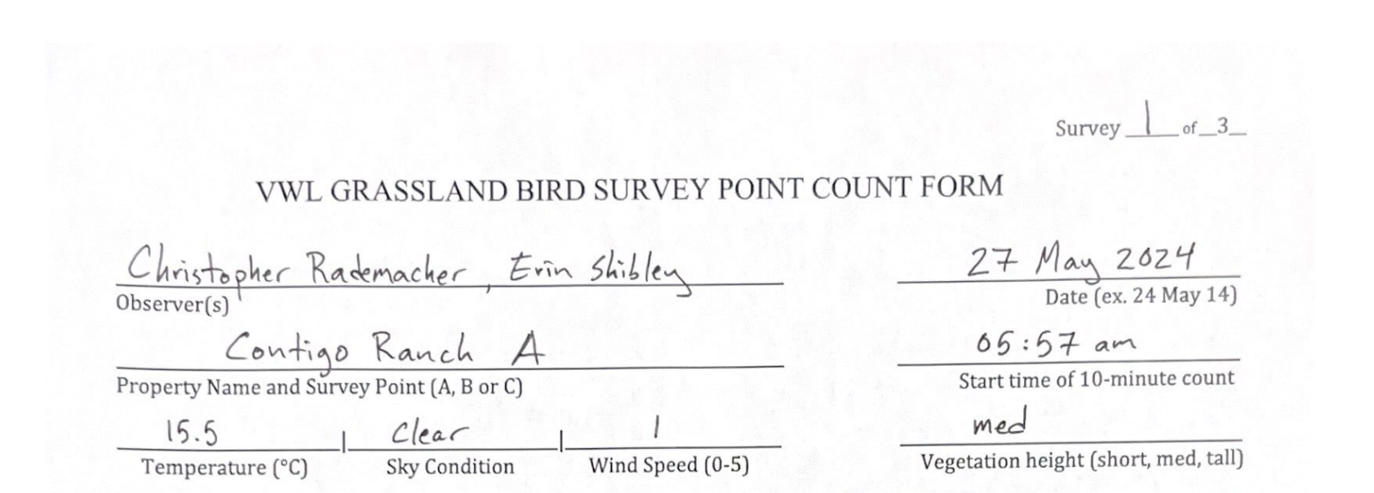
DO NOT LEAVE ANY SPACES BLANK
Notes:
Surveyors will go out in pairs; one person will be the primary observer while the secondary surveyor records observations.
When you (quietly) arrive at the survey point, you fill out the entire top section of your datasheet before you begin your point count survey. By the time you’ve finished quietly recording these data, you’ve allowed the birds to better acclimate to your presence.
Please do not leave any spaces blank!
Use only pencil or indelible ink

Slide 11
DO NOT LEAVE ANY SPACES BLANK
Notes:
Start time of 10-minute count will be filled out after you have entered all other data in the top section, so ignore it until you’re ready

Slide 12
Notes:
We start with recording the full names of the observers, the property name and survey point, and the date.
We also record in the top right is this was our 1st, 2nd, or 3rd visit to the site

Slide 13
Notes:
Temperature:
- recorded in degrees Celsius
- If you don't have a thermometer or a smartphone weather app, review the weather data on your home computer after returning from the field.

Slide 14
Notes:
Sky Condition:
- Recorded using one of the following terms below:
• Clear (can include a few clouds)
• Partly Cloudy (ca. 10% to 60% cloudy)
• Cloudy (more than ca. 60% cloudy)
• Fog (includes mist, but not haze)
DO NOT SURVEY IN RAIN SHOWERS, HEAVY FOG OR SNOW

Slide 15
Notes:
Wind Speed: - Given according to the Beaufort Scale (Look up to a height of about 3 m for the indicators of wind)
0 0 Smoke rise vertically, absolutely still conditions
1 1 to 3 Wind direction shown by smoke drift
2 4 to 7 Wind felt on face; leaves rustle
3 8 to 12 Leaves and small twigs in constant motion
4 13 to 18 Raises dust, loose paper and small branches
5 19 to 24 Small trees in leaf sway
DO NOT SURVEY IF WINDS ARE A 4 OR 5

Slide 16
Notes:
Short = < 0.5 m (below your knee)
Med = 0.5 – 1 m (between your knee and your hip)
Tall = > 1 m (above your hip)

Slide 17
Notes:
Once all the data has been recorded for this top section, the primary observer readies their binoculars.
The secondary observer will prime the 10-minute stopwatch and, when both observers are ready, the secondary observer will record the start time of the 10-minute count and your survey begins!

Slide 18
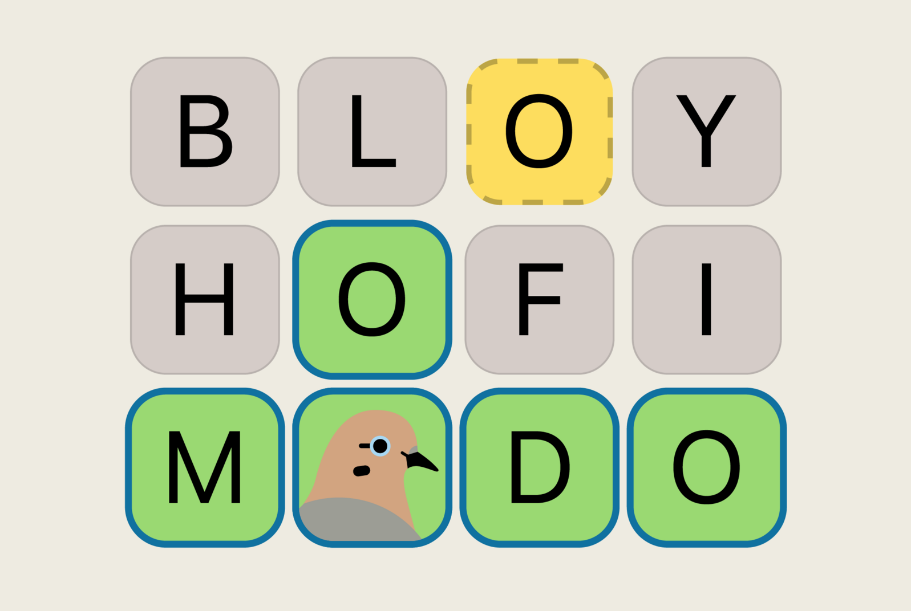
Alpha Codes
BRDL
Notes:
So before we get into recording observations, I want to take a second to introduce alpha codes, as this is how we record species observed while conducting our point count surveys.
- I’m not sure how familiar y’all are with Wordle, but there is a fun spinoff of the game called BRDL.
- BRDL is a game that incorporates the four-letter alpha codes into the Wordle gameplay. I’d recommend giving it a shot!
Oftentimes, birders use this specialized code when taking notes about the various bird species they have seen. This code may seem confusing at first, but the framework is a logical system at work and we’ll briefly break it down on the next slide.
The codes are alphabetic (hence the name alpha codes) and have been used by ornithologists as a quick and accurate way of recording data when doing bird surveys.
If for nothing else, alpha codes save time when writing and help to avoid confusion through a standardized naming system.

Slide 19
Alpha Code Rules
Notes:
So, this is a LOT of text, but I’ll break it down a bit:
Generally, the way the code is devised is by using letters from the bird’s common name.
->
- For birds with one name, the alpha code is the first four letters Ex. BOBO
- For birds with two-word names, the alpha code is the first two letters of each word Ex. COYE
- We’ve got two different ways to create alpha codes for three word names depending where the hyphen is located. Ex. YBCU vs. EAWP
- Three word names, you take the first letter from the first two words and two letters from the third word ex. GBHE
- Four word names, one letter per word ex. NRWS
We will provide you with a current list of alpha codes for use while in the field and to practice with at home. This chart is on that list!
Don’t stress too much about this, I just wanted to introduce the concept here so the next few slides will make more sense.

Slide 20
Point Count Methodology
Notes:
Now we begin to fill in our point count observations! This is what the datasheet will look like.

Slide 21
Point Count Methodology
Notes:
During the first 5 minutes (up until 4m 59s), you record your observations in the 0-5 min columns.

Slide 22
Point Count Methodology
Notes:
Once you have reached the 5-minute mark, move over to the 5-10 min columns and record observations. Please do not pause between the two 5-minute periods.
->
Record the alpha code of every individual bird you see and hear within 100m.
If you see 5 American goldfinches, use one row for each of them.
Record whether the bird is 0 - 50m or between 50m - 100m (these are known as distance bands).
Note how each bird is detected as Seen only (S), Heard only (H), or both (SH).
Record detection method in respective distance band columns

Slide 23
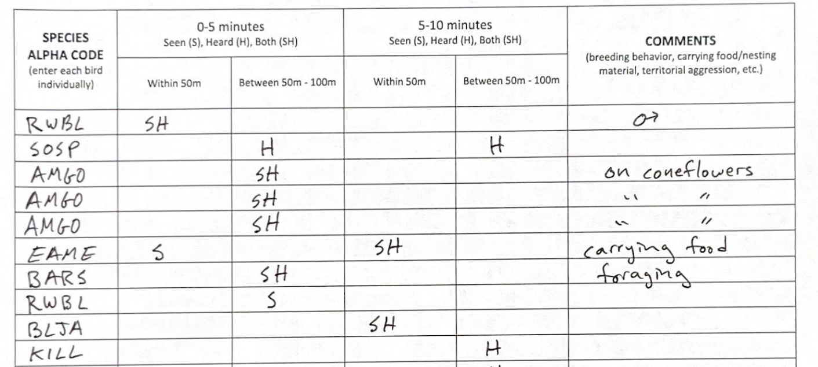
Point Count Methodology
Notes:
You’ll record the alpha code of every individual bird you see and hear within 100m (for each 5-minute period) whom are actively foraging and landing in the survey field. (we’ll go over flyovers and incidental birds in a few slides)
->
If you see 3 American goldfinches, use one row for each of them.
Record whether the bird is 0 - 50m or between 50m - 100m (these are known as distance bands).
Note how each bird is detected as Seen only (S), Heard only (H), or both (SH).
Record detection method in respective distance band columns

Slide 24
Point Count Methodology
Notes:
If you see 3 American goldfinches, use one row for each of them.

Slide 25
Point Count Methodology
Notes:
Record whether each bird is within 50m or between 50m - 100m (these are our distance bands that I mentioned earlier).

Slide 26
Point Count Methodology
Notes:
Finally, note how each bird is detected as Seen only (S), Heard only (H), or both (SH).
- Record detection method in respective distance band columns
For this example, these three AMGO were both Seen and Heard between 50-100m in the first 5 minute period.

Slide 27
Point Count Methodology
Notes:
If an individual bird is moving throughout the survey plot for all 10 minutes, record the distance band where the bird was first detected for each time period
In this example, an EAME was seen within 50m during the first 5 minute period. It was moving throughout the survey field going between the 0-50m distance band and the 50-100m distance band but never leaving the survey boundaries.
However, when the second 5 minute period started, that same EAME was back in the 0-50m distance band and was now singing. The observer properly recorded it as SH within 50m on the same row.

Slide 28
Point Count Methodology
Notes:
If a new individual is detected only during the second 5 minute period, the observer would note detection method and distance in the 5-10 minute coloumns, creating a new row for the individuls
In this example, a BLJA was observed landing on a snag and calling within 50m of the survey point. The observer recorded it as SH within 50m

Slide 29
Point Count Methodology
Notes:
This observer detected a BARS foraging over the survey field, between 50 – 100m. While BARS are not often observed directly landing in survey fields, we count aerial insectivores like swallows, CHSW, and PUMA as official survey observations as long as they are seen foraging.

Slide 30
Point Count Methodology
Notes:
Additionally, while recording survey observations, feel free to record any comments about breeding behavior, food or nesting behaviors, territorial aggression and more
Be sure to avoid counting any birds that may have been counted at your previous point(s).

Slide 31
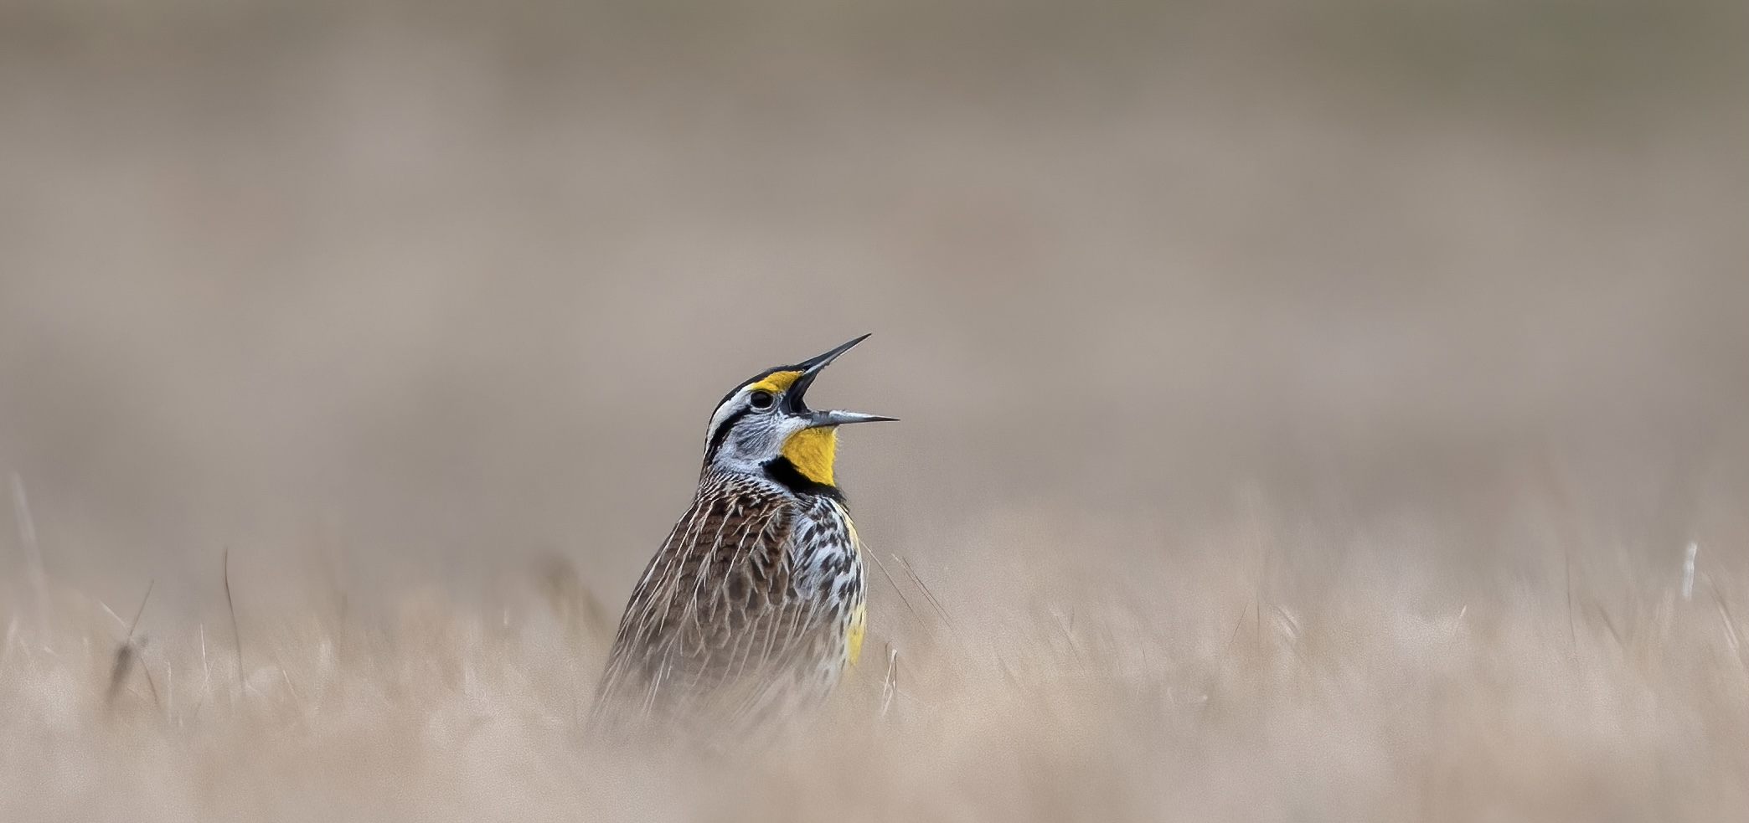
Point Count Methodology
Time’s Up!
Notes:
Once the 10 minutes is up, stop recording birds and quietly move to your next survey point to start your next survey. Do not exceed the 10-minute time limit simply because you are sure a "good bird" is there and not calling – if it’s there, it will be recorded on another visit. Also remember, absence of a species is as important as presence in this survey.

Slide 32
Point Count Methodology
Notes:
I know most of us will be seeing birds outside of our official surveys and we encourage our surveyors to record these observations as incidentals…
These are any birds that are recorded as flyovers, are observed outside of the 100m survey boundary, or observed before and/or after the survey period including those observed walking to and from your assigned fields.
(Essentially, any birds not observed actively using the survey field during the official 10-minute point count)
These records are not used for data analysis but are important so that we can provide landowners with a list of species detected on their properties during your visits.

Slide 33
Point Count Methodology
Notes:
You may record incidentals at the bottom of your datasheet in two spots.
The first is here, where you record any birds observed flying over the survey field during the 10-minute official point count.
- These surveyors observed three CANG, a TUVU, a GBHE, and a CORA flying over the field during their official survey.
- Swallows, CHSW, and PUMA that are foraging above the field are considered official survey observations and are not recorded in the Flyovers section

Slide 34
Point Count Methodology
Notes:
This middle section is where you record any birds that are observed while walking to or from the survey points. These included birds that fly over as you’re walking.
- remember that the official “flyover” section is reserved for birds that are observed flying over the field while conducting an official survey

Slide 35
Point Count Methodology
Notes:
This section is to record any notes about the property as you’re conducting surveys.
It can also be where you describe any birds you observe but are not sure about the identification. If there is a bird (or birds) on your site that you cannot identify, make sure to include it on your data sheet as “unknown” with any appropriate detection methods.
- Take field notes that will help you identify it later on, (i.e. take pictures, sketch a drawing, note its behavior, record its songs, etc.)
- If you get really stumped, we can have a VWL staff member come out with you on one of your surveys

Slide 36
Point Count Methodology
Notes:
This year’s datasheet will look slightly different as we’ll be assisting the Turtle Conservation Ecology Lab with collecting presence/absence data of Eastern Box Turtles.

Slide 37
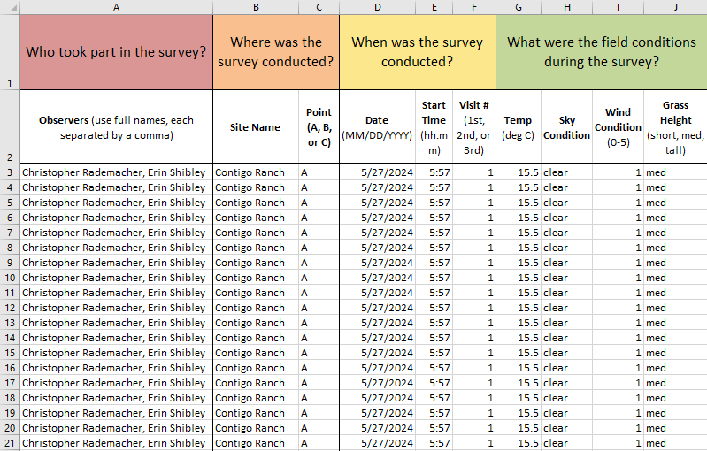
Entering Data
Notes:
I won’t spend too much time on entering data as we will be providing a video covering this topic in greater detail, but I wanted to bring it up as it’s a crucial part of recording these survey data.
Survey groups will designate someone to enter the data collected during your 3 point counts to the Excel file provided to you after every survey visit.
Once the data is entered, save your work and send the file to the Survey Coordinator.

Slide 38
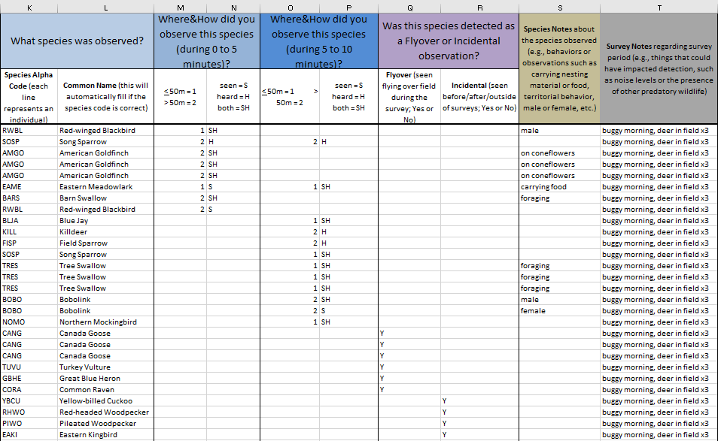
Entering Data
Notes:
I won’t spend too much time on entering data as we will be providing a video covering this topic in greater detail, but I wanted to bring it up as it’s a crucial part of recording these survey data.
Survey groups will designate someone to enter the data collected during your 3 point counts to the Excel file provided to you after every survey visit.
Once the data is entered, save your work and send the file to the Survey Coordinator.

Slide 39
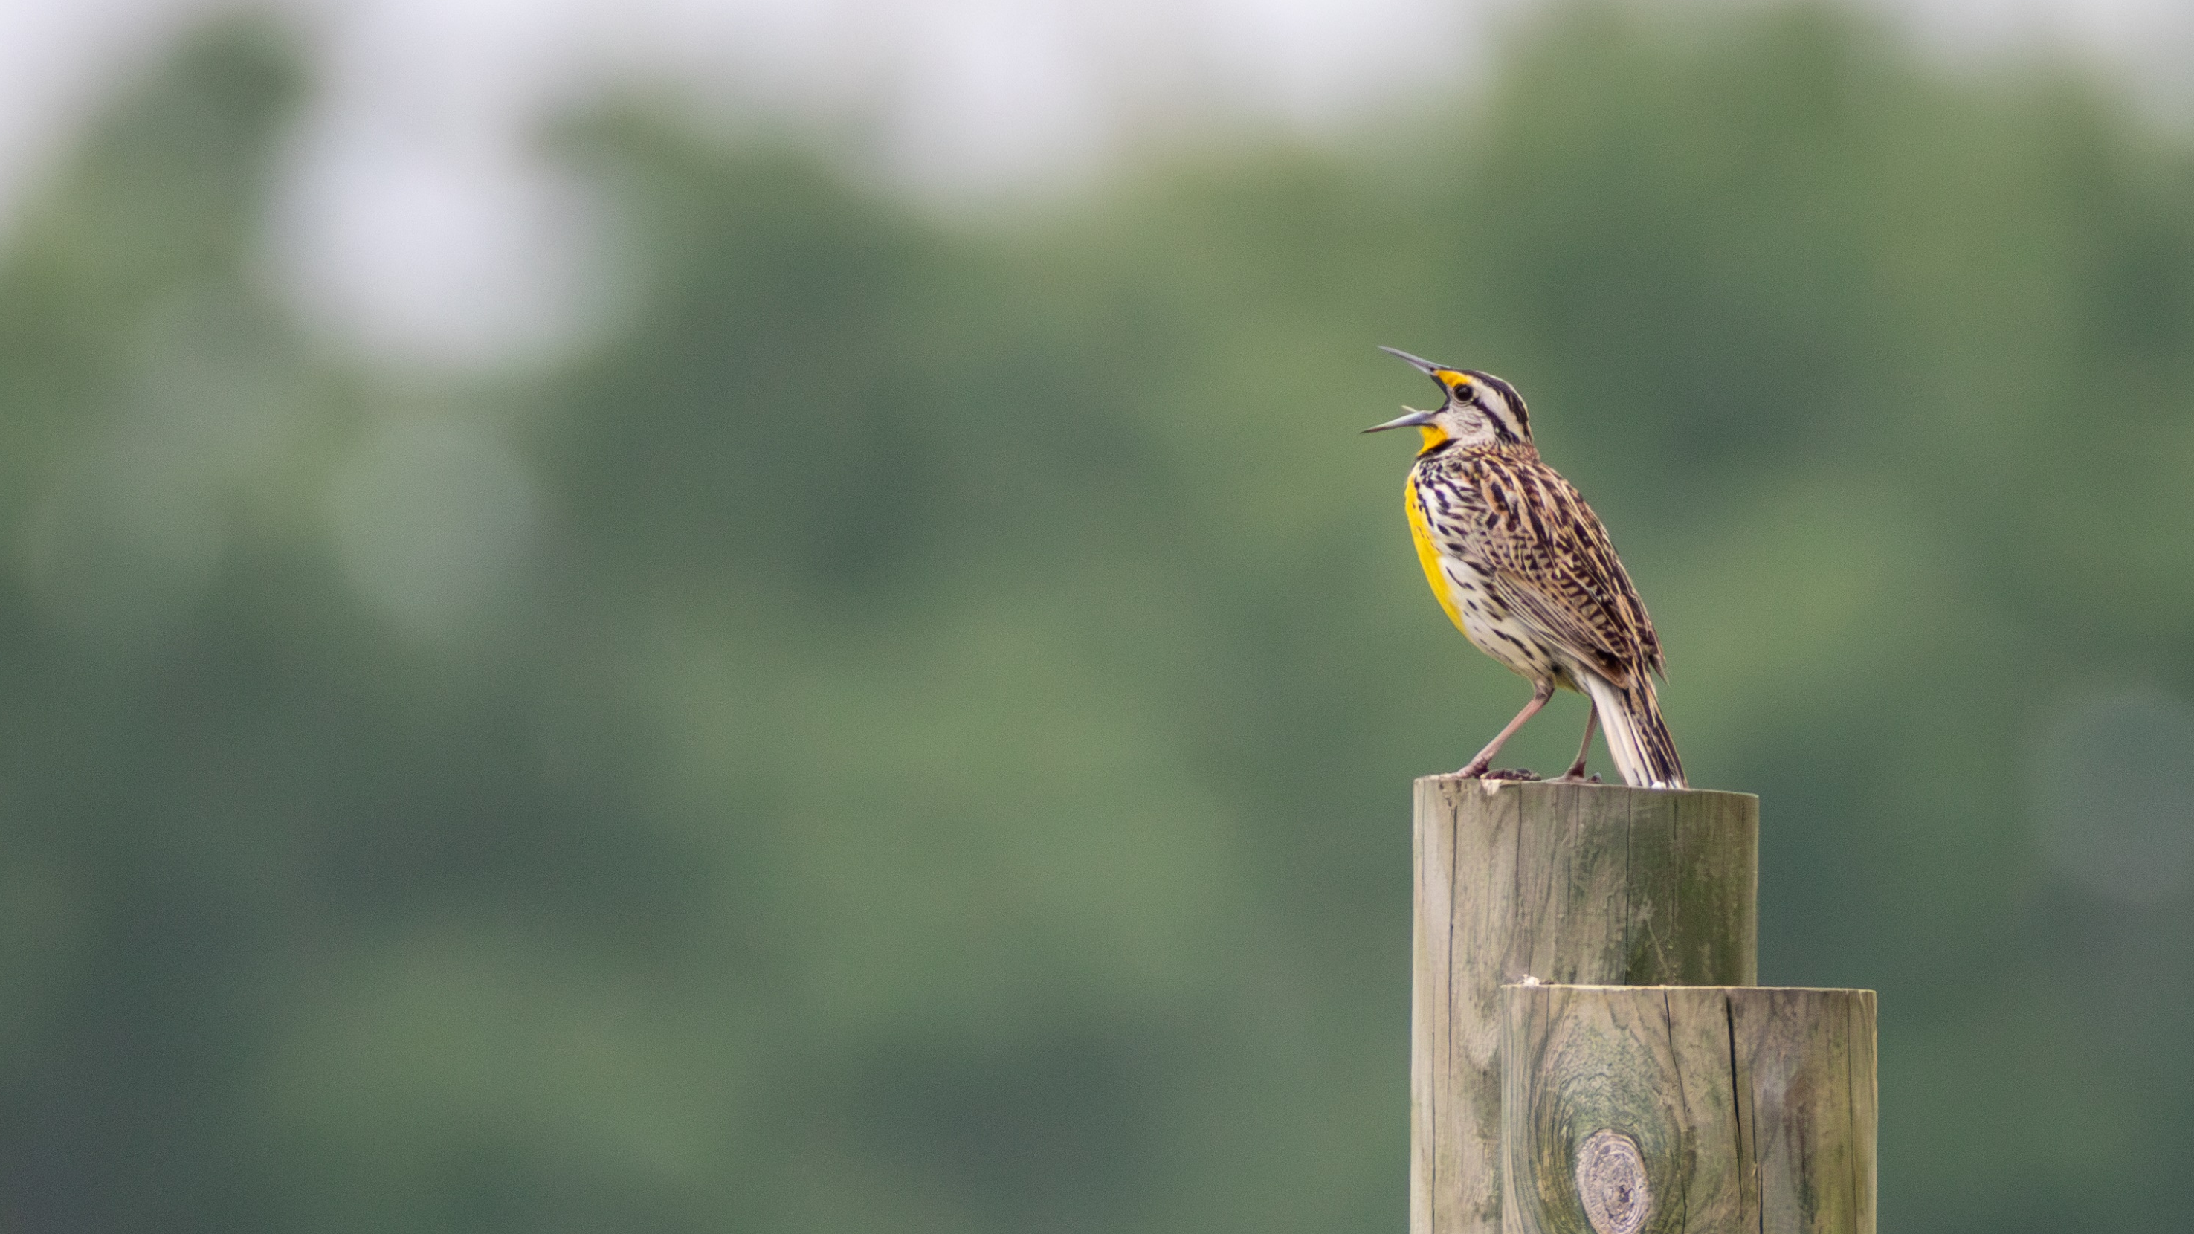
Bird ID Tips
Song
Size and Shape
Color and Pattern
Behavior
Habitat
Notes:
I’d like to end with some ID tips and resources to help you prepare for survey season!
When identifying a bird, we take note of aspects like song, size/shape, color/pattern, behavior, and habitat.

Slide 40
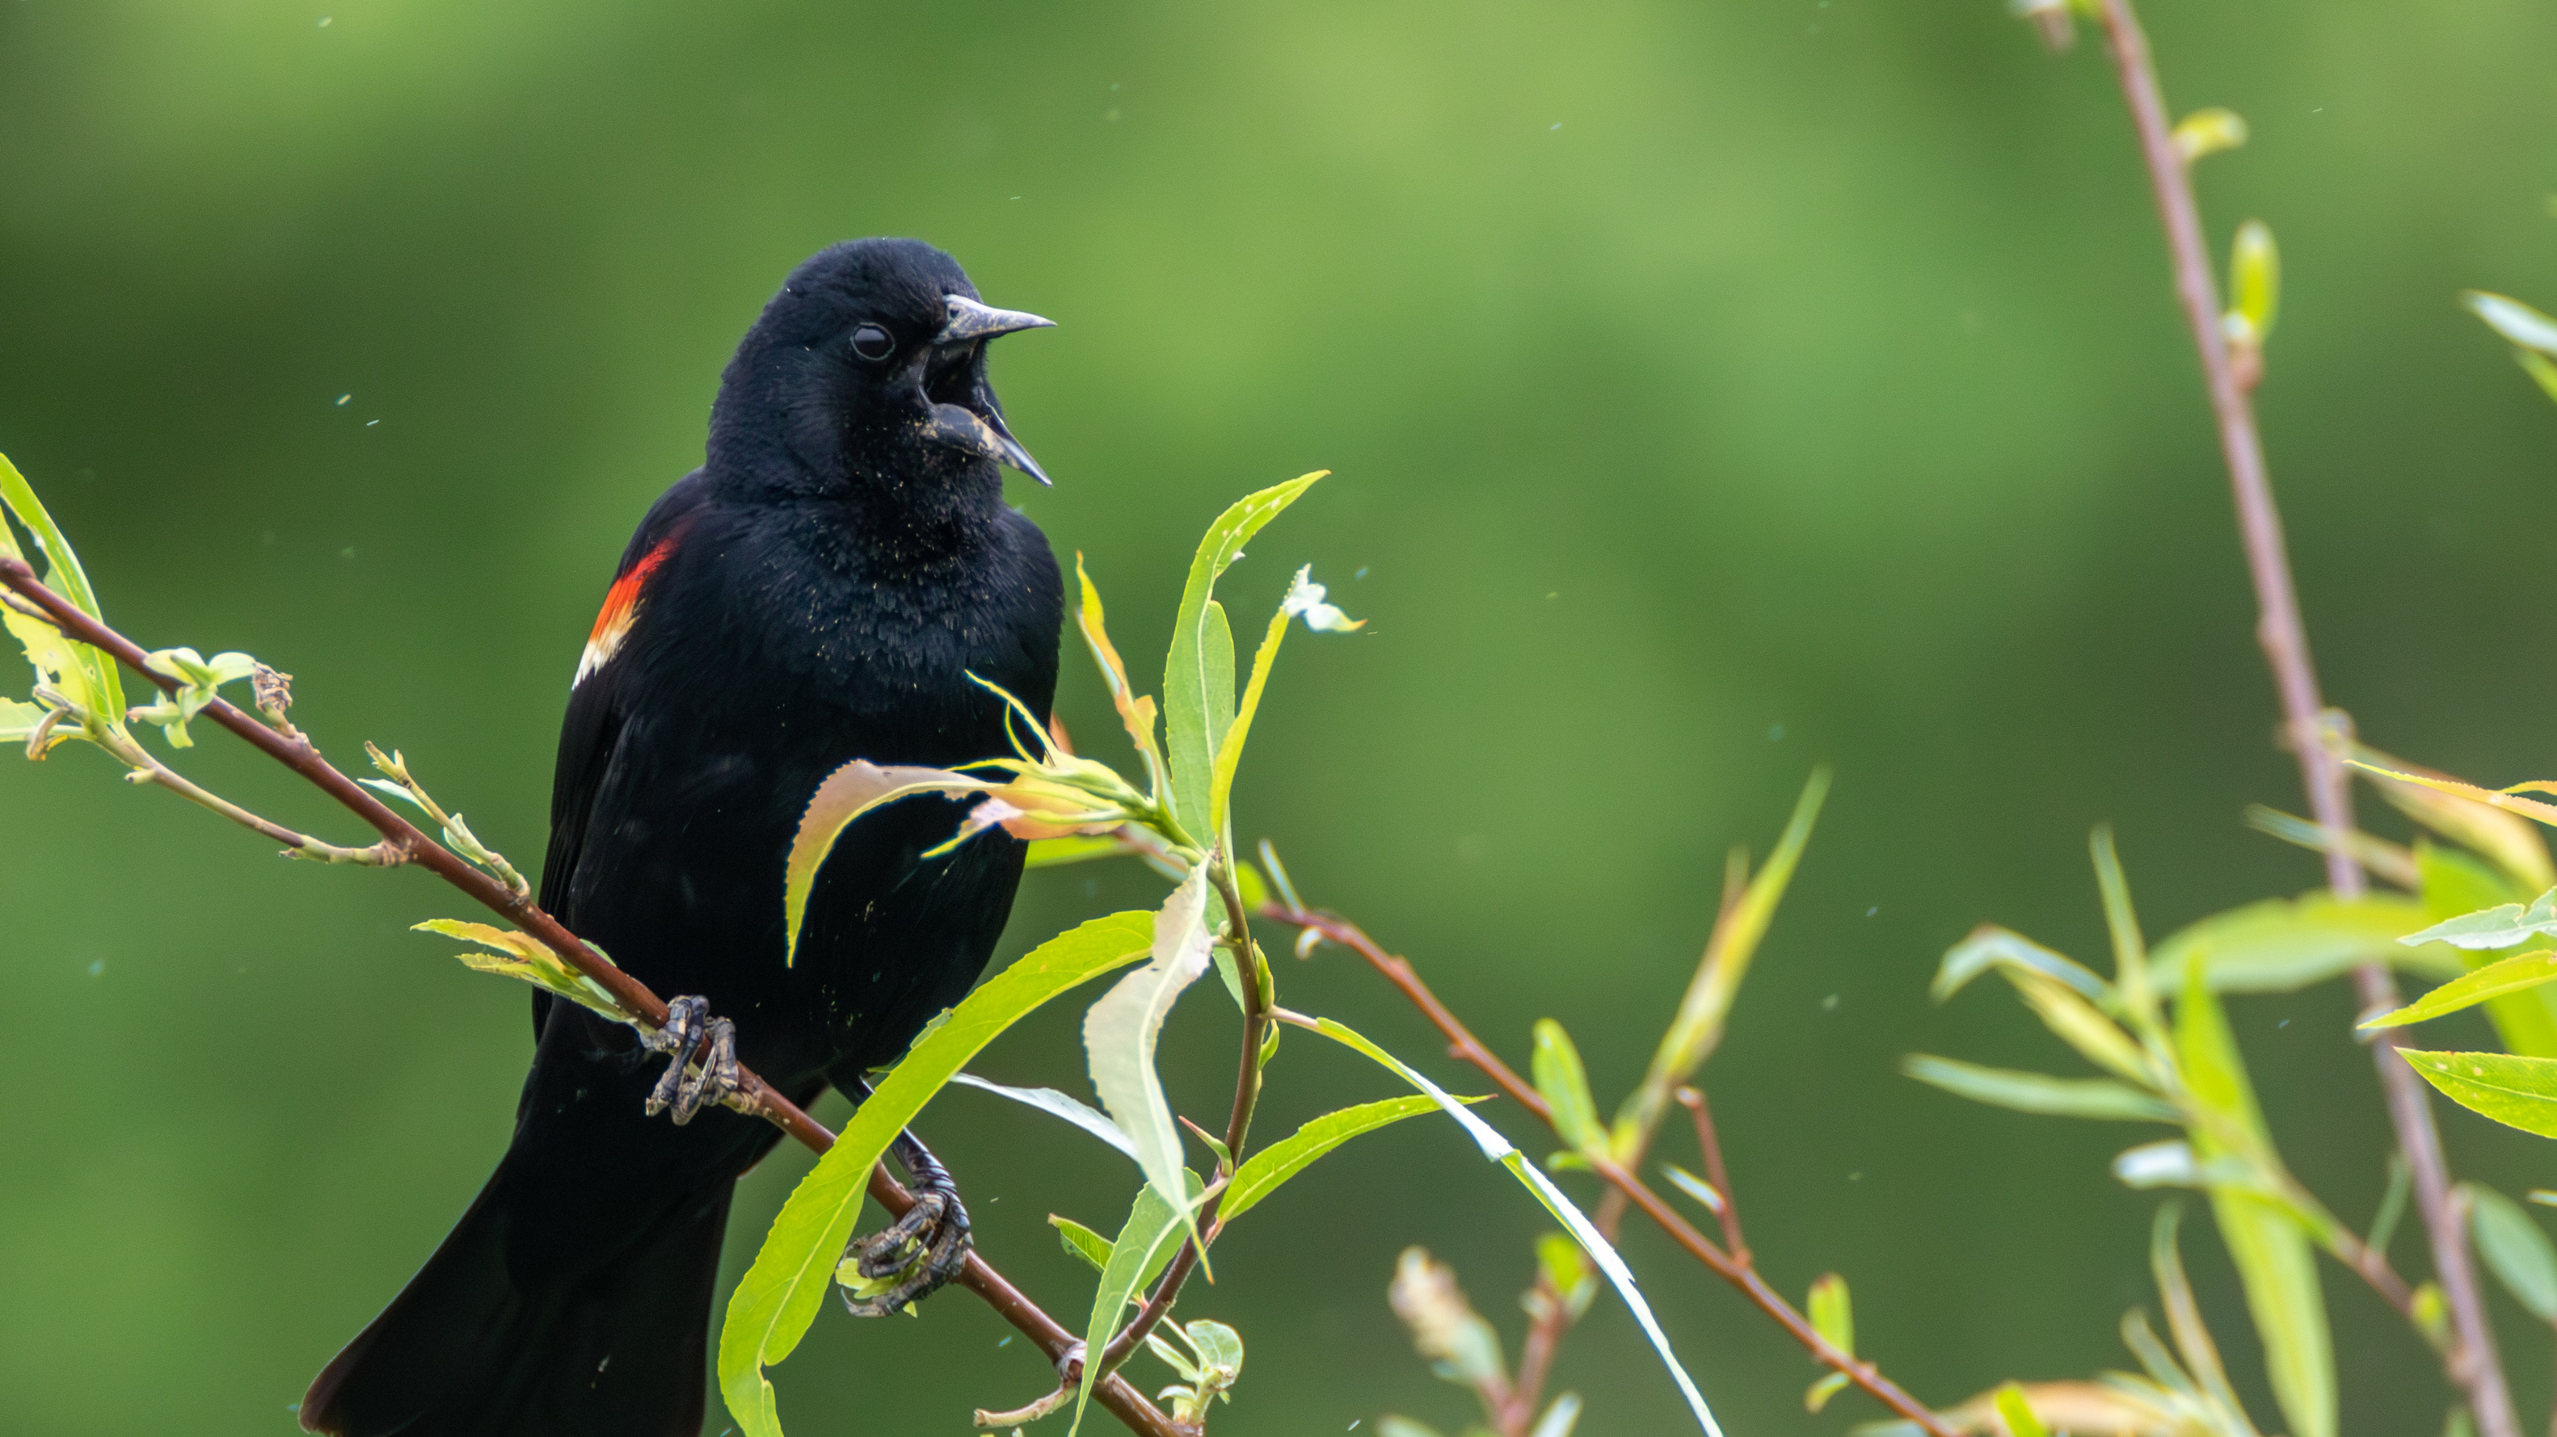
Bird ID Tips: Song
Clear whistle or harsh/unmusical?
Descending or rising?
Low or high frequency?
Note repetition or new notes?
Notes:
Clear whistle or harsh/unmusical?
Descending or rising?
Low or high frequency?
Note repetition or new notes?

Slide 41
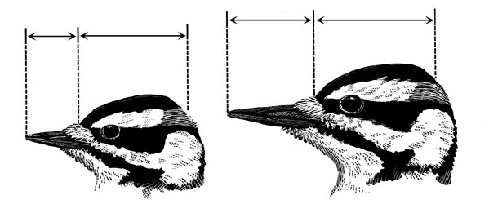
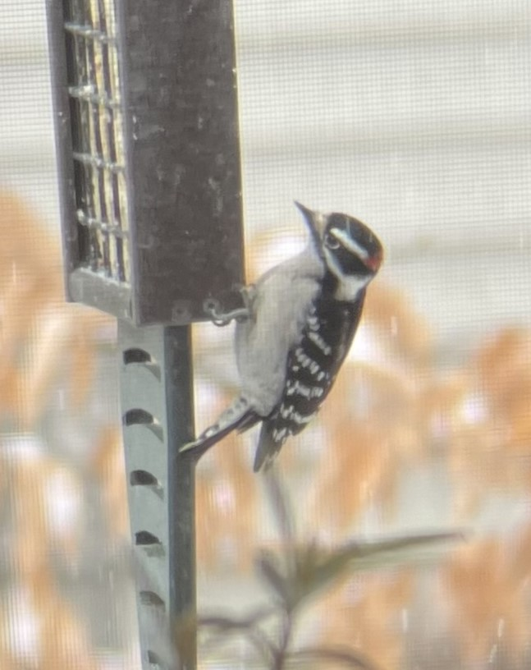
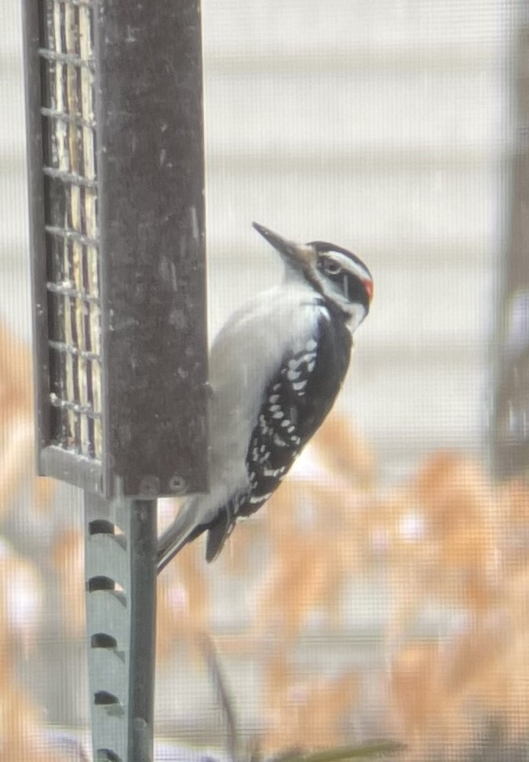
Bird ID Tips: Size & Shape
Place bird into size category
Squat, stocky, tall or thin?
Crest on head?
Focus on size and shape of bill, tail or feet
Downy Woodpecker
Hairy Woodpecker
Notes:
-Place bird into a size category based on common objects (phone, loaf of bread, etc.) or common birds
-Is the bird squat, stocky, tall, or thin? Does it have a crest on its head? Focus on the shape of the bill, tail, or feet. Bill shape/size can help clue you into what family the bird belongs to
Ex. Downy and Hairy woodpeckers look almost identical and occur in similar habitats. One of the best ways to tell them apart is to judge the length of the bill compared to the head. The Downy Woodpecker's measures only about half the length of its head. The Hairy's is about the same length as the head.

Slide 42
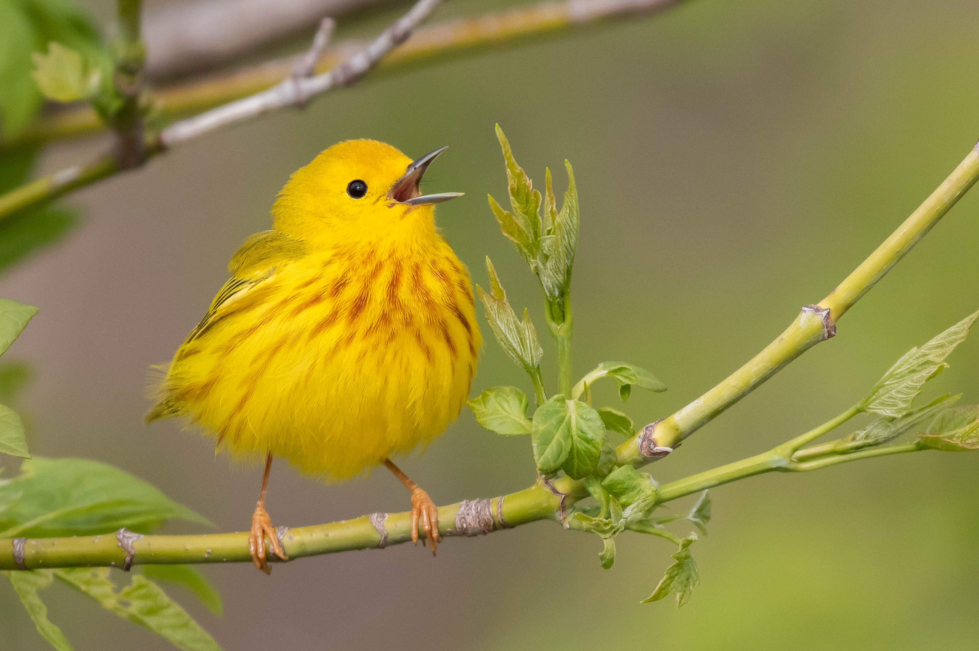
Bird ID Tips: Color & Pattern
What are primary colors of bird?
Colors of bill, legs and feet?
Does bird have wing bars, eye stripes, streaks, or spots?
Notes:
What are the primary colors on the bird?
What are the colors of the bill, legs, and feet?
Does the bird have wing bars, eye stripes, streaks, or spots?

Slide 43
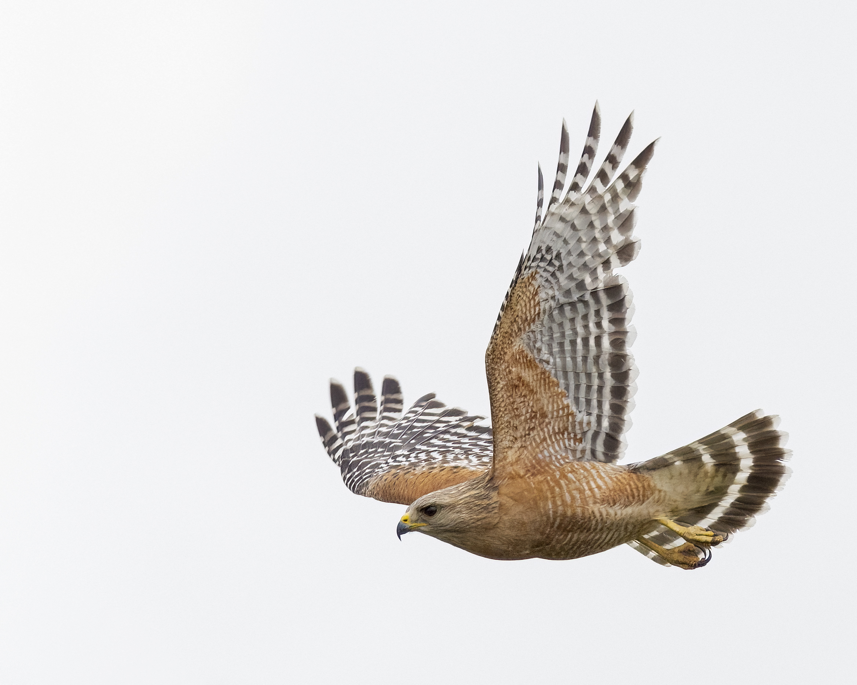
Bird ID Tips: Behavior
How does it move through the landscape?
Is it soaring in the sky or flitting in a tree?
Notes:
How does it move through the landscape?
Is it soaring in the sky or flitting in a tree?
Is it acting territorial?

Slide 44
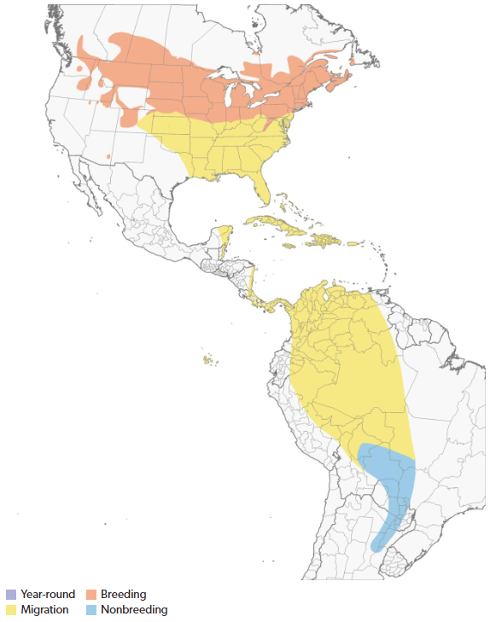
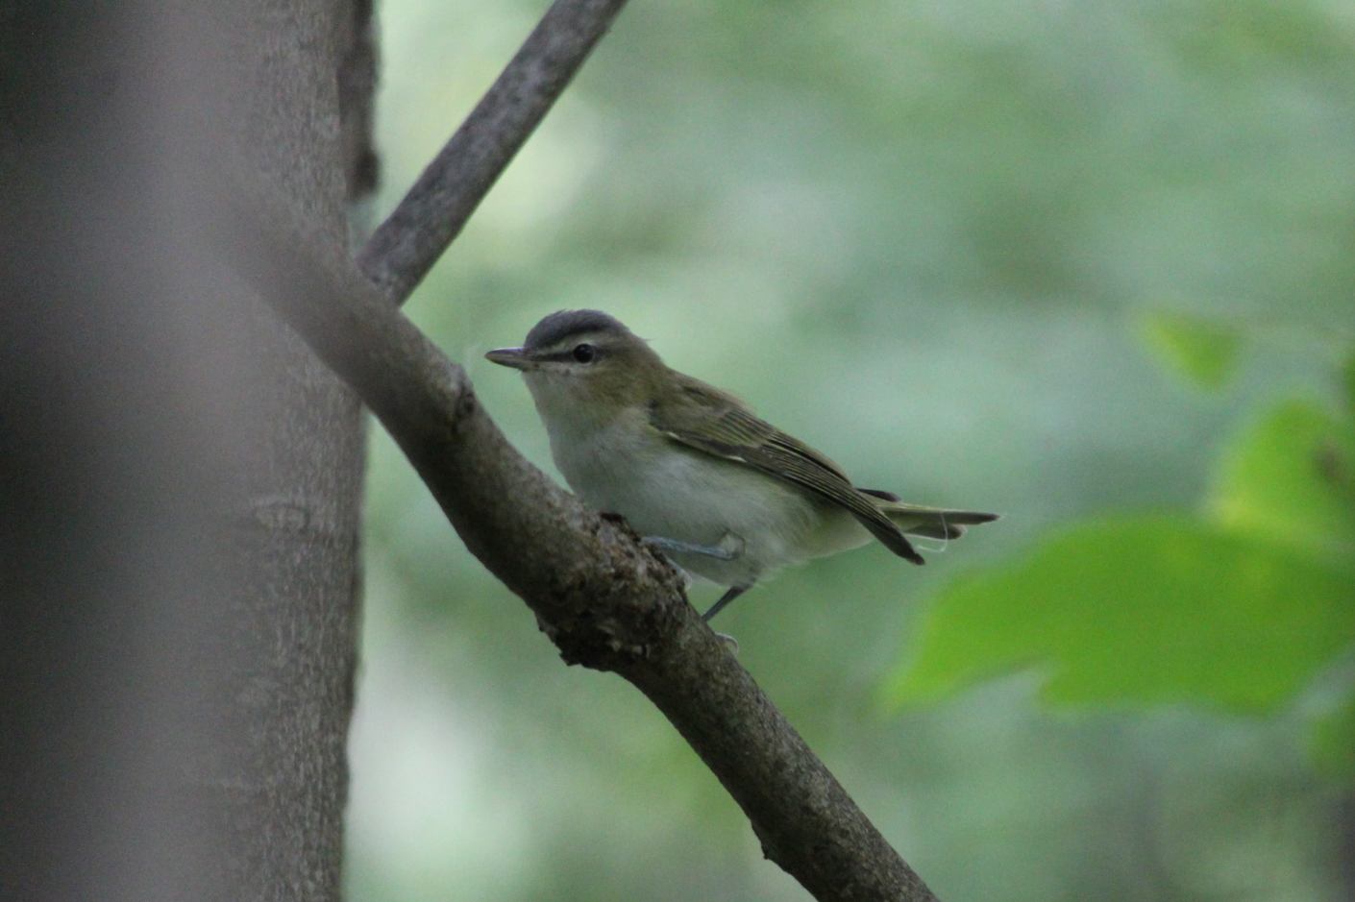
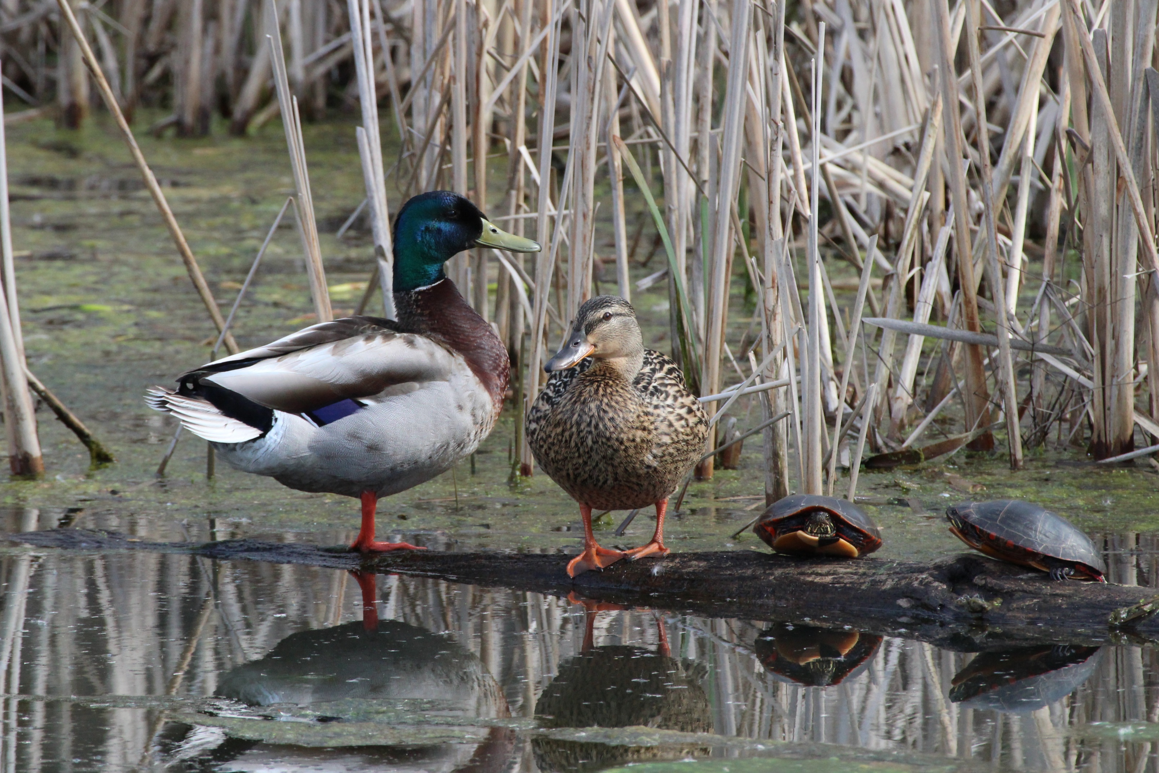
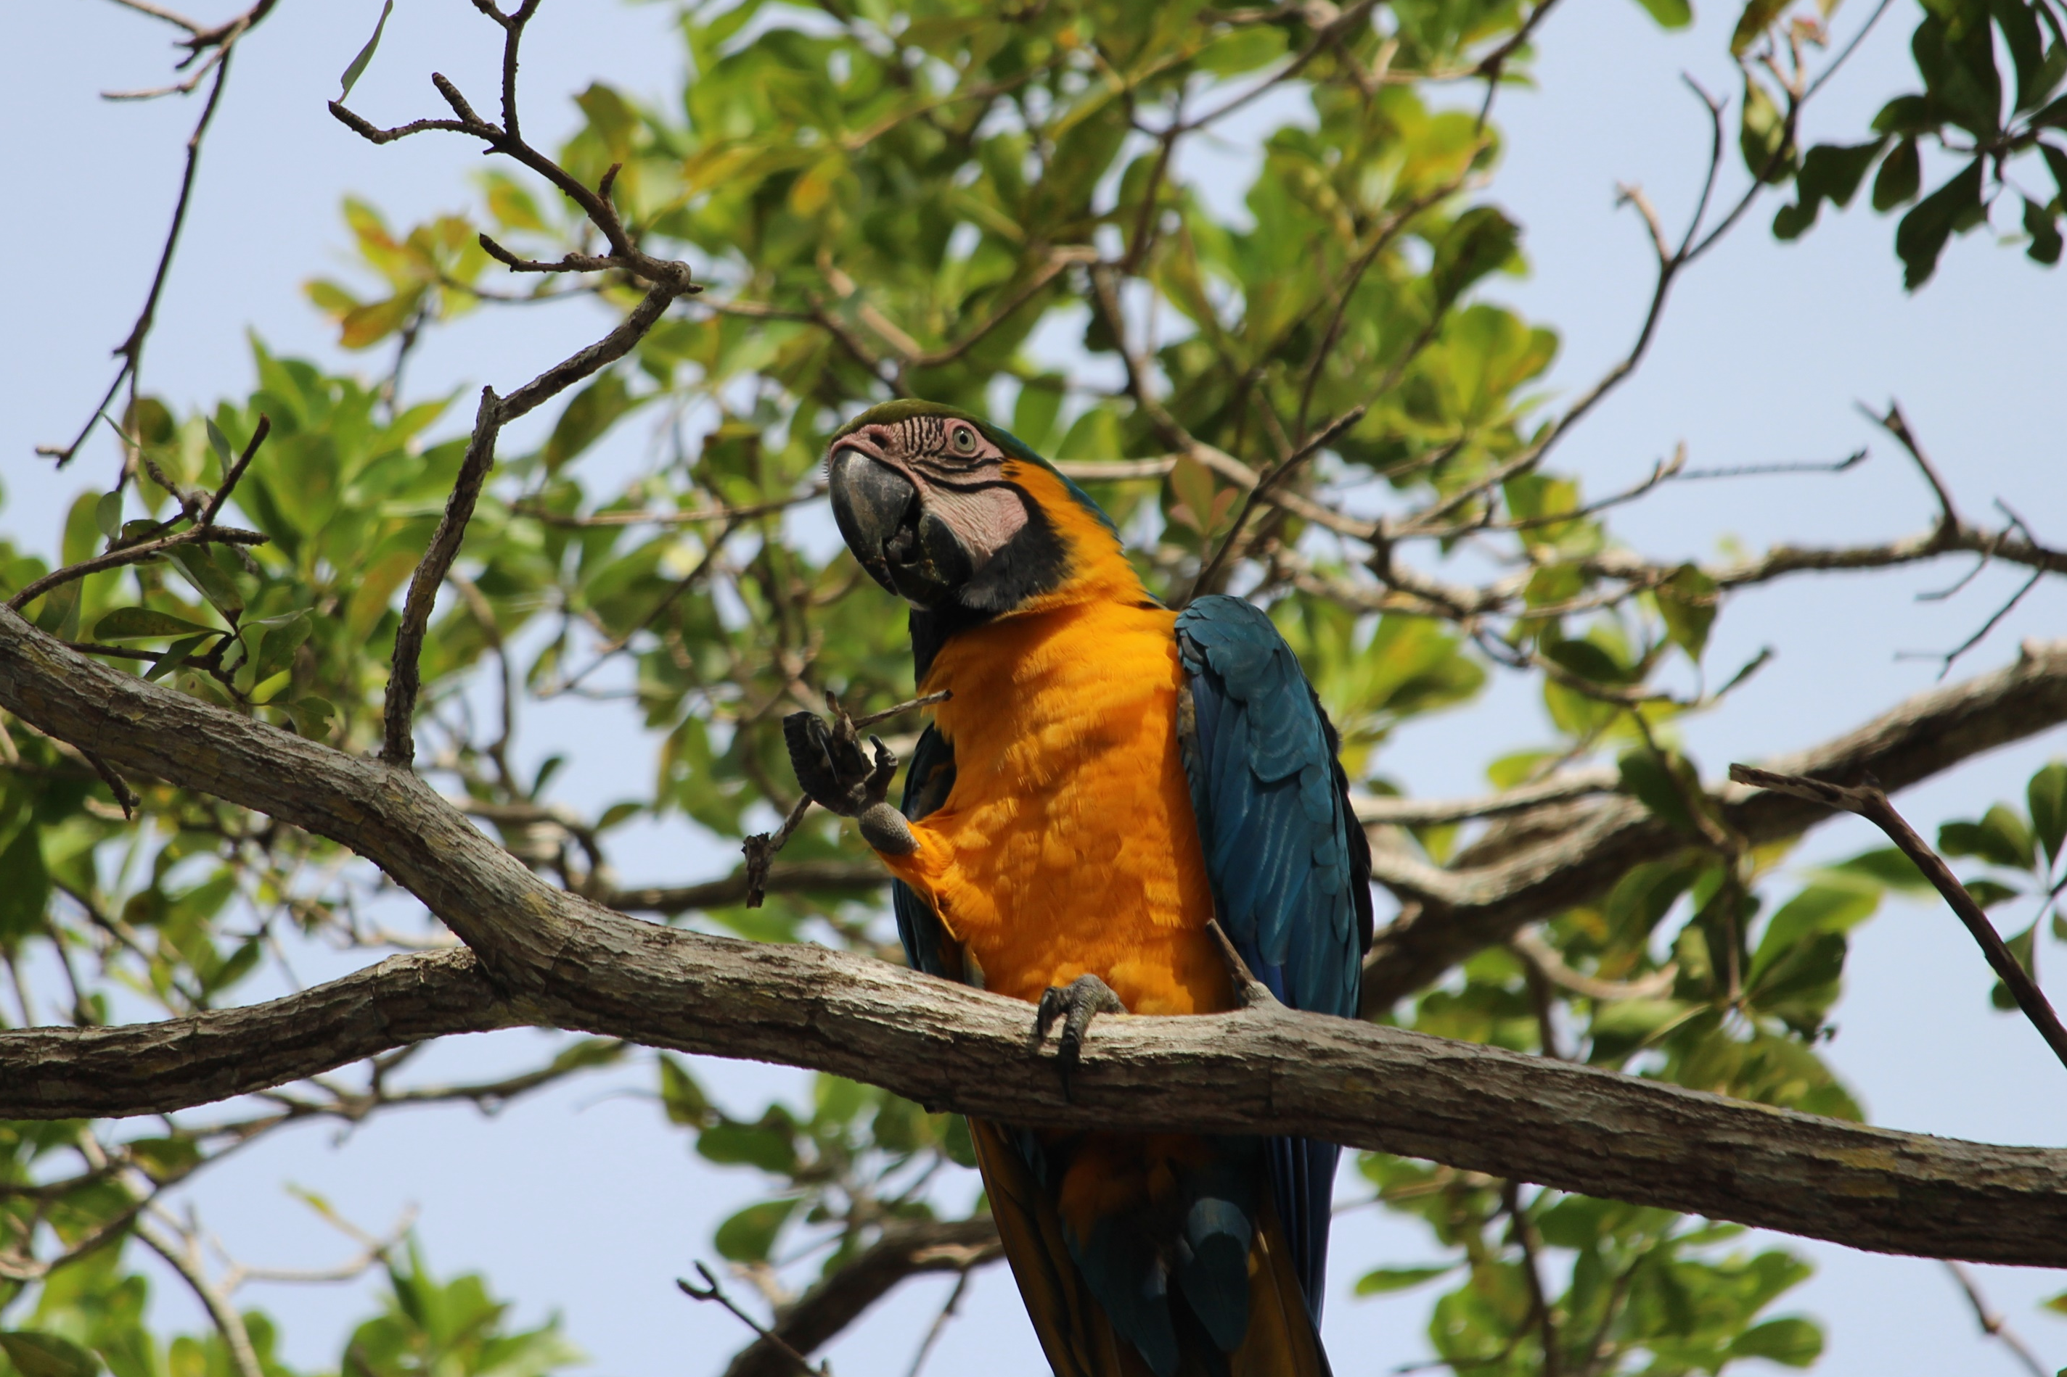
Bird ID Tips: Range/Season/Habitat
What habitat are you in, grassland, forest, wetland or urban?
Are you in the birds expected range?
What time of year is it?
Notes:
Each species of bird is predictably found in a particular habitat and each habitat contains a predictable assortment of birds. Having knowledge of bird habitat preferences is one of the best ways to sort out which birds you are most likely to encounter. Is the bird in grassland, a forest, a wetland or an urban area?
Migratory birds like warblers may only be in VA for a few months each year
Some birds like cardinals or bluebirds can be found in VA year round.
VA has many diverse habitats like wetlands, forests, and grasslands, that host their own groups of birds!

Slide 45
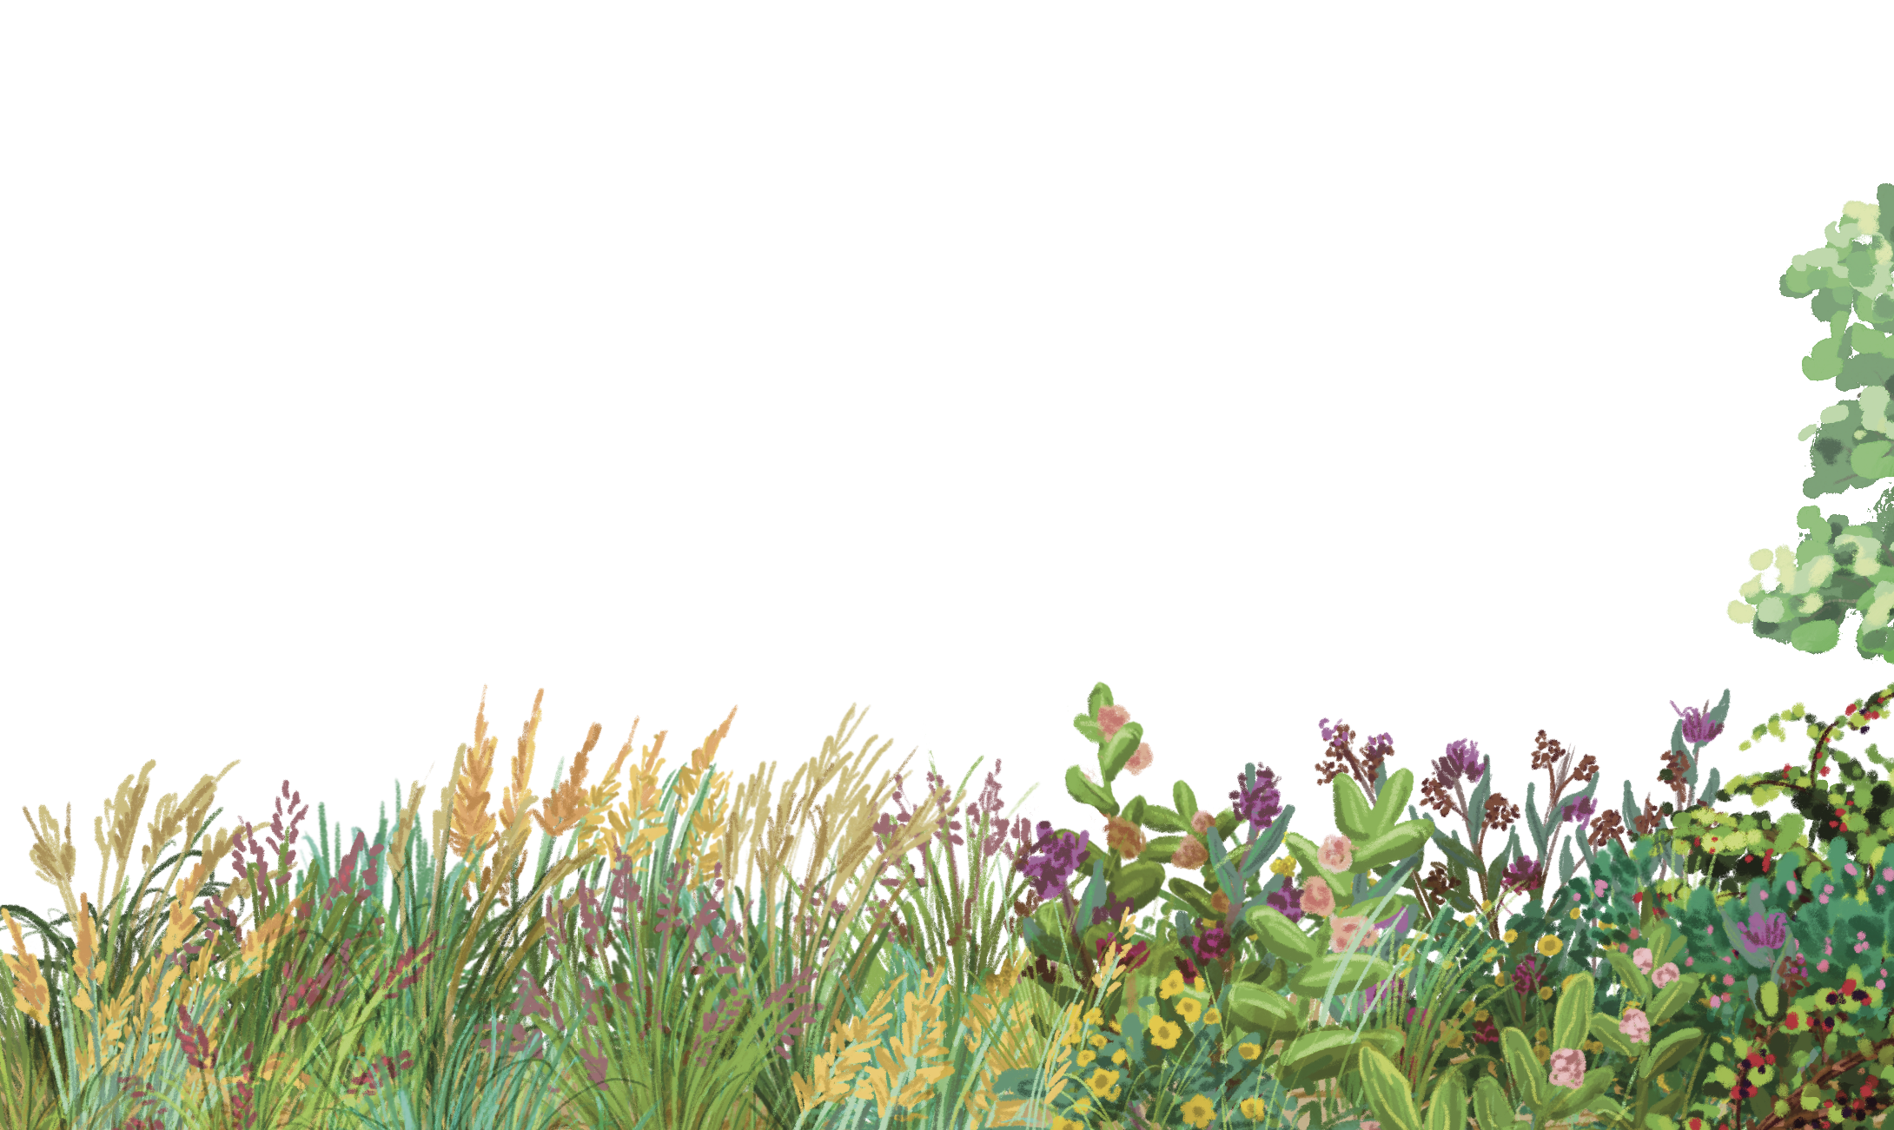
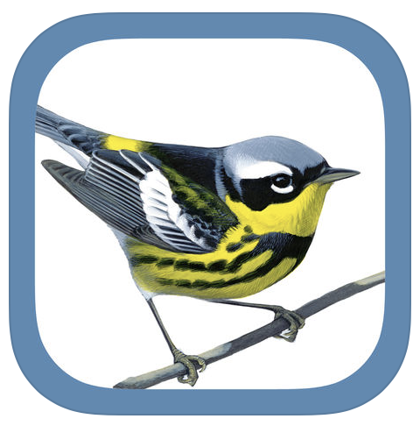
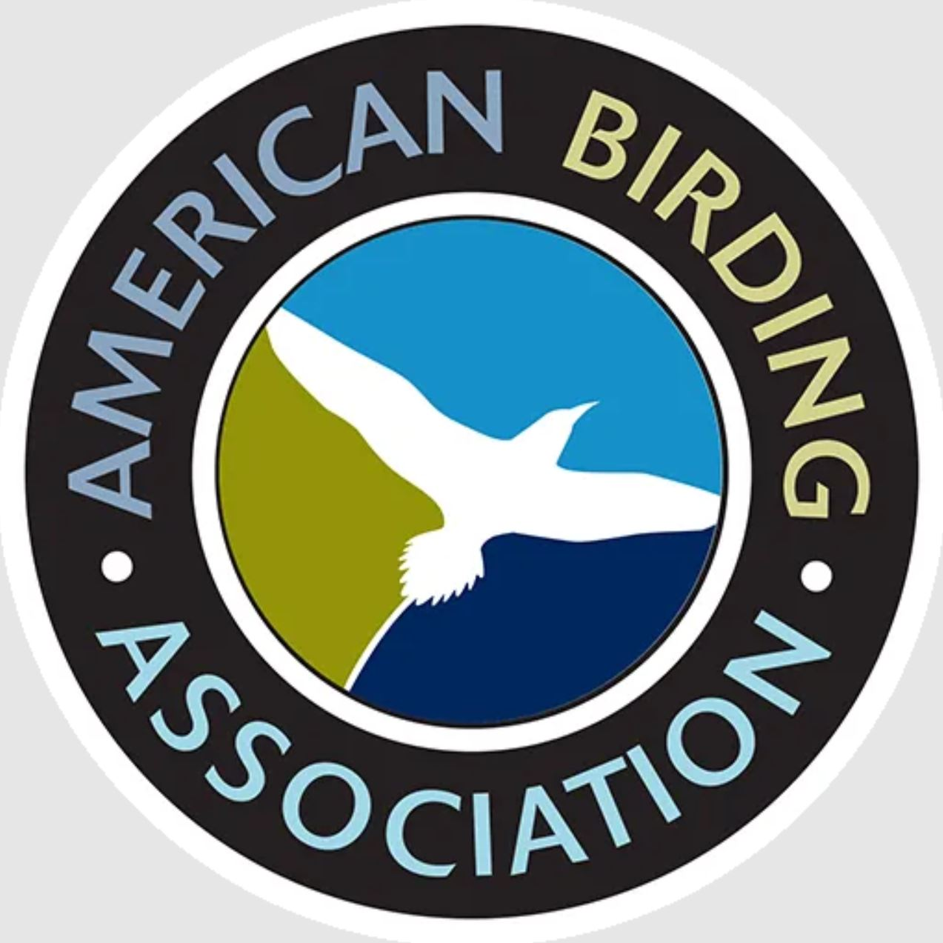
Bird Resources
Helpful Websites:
(Audubon.org)
(aba.org) (virginiabirds.org)
All About Birds (allaboutbirds.org)
eBird (ebird.org)
Helpful Apps:
Merlin Bird ID
Larkwire App ($$)
Chirp! Birdsongs App ($)
Sibley Birds 2nd Edition ($)
iNaturalist
Notes:
I’ve listed some websites and apps that are helpful with bird identification and general bird knowledge. We will also have detailed resources available on the future VWL website volunteer page.

Slide 46
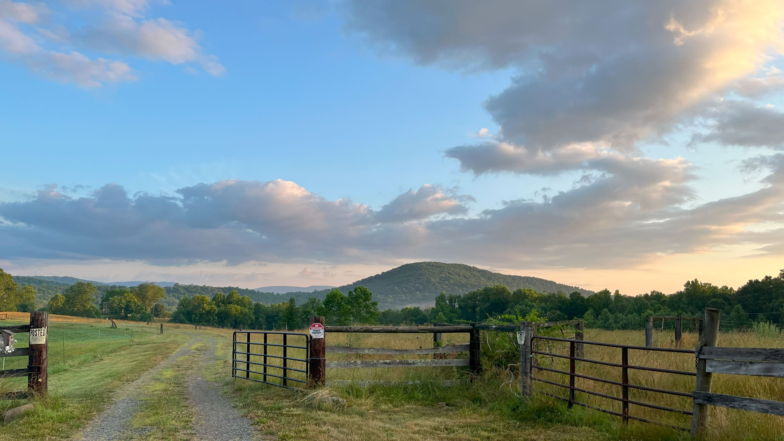
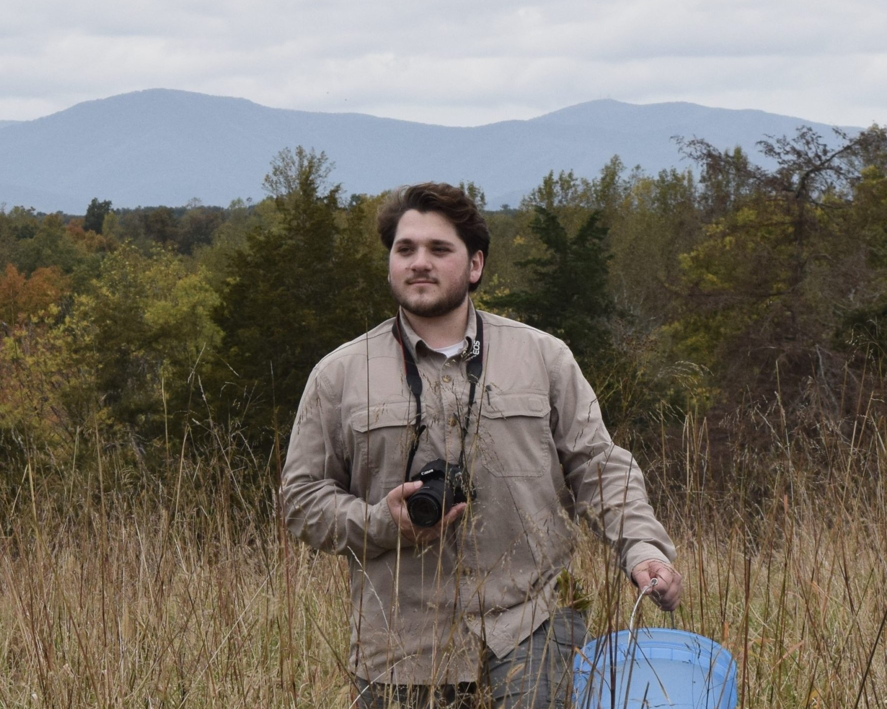
Happy Birding!
Christopher Rademacher
Biodiversity Technician
rademachercj@si.edu
Notes:
And with that, Thanks for your time today! I’d be happy to answer any questions you may have throughout the rest of the morning!

